Slide 1
LOGARITHMIC FUNCTIONS
Objective: To Rewrite and Evaluate Logarithmic Functions

Slide 2

Let’s Get Started…
Solve the following two step equations:
$5x−12=33$
$\frac{1}{2}x+8=18$

Slide 3
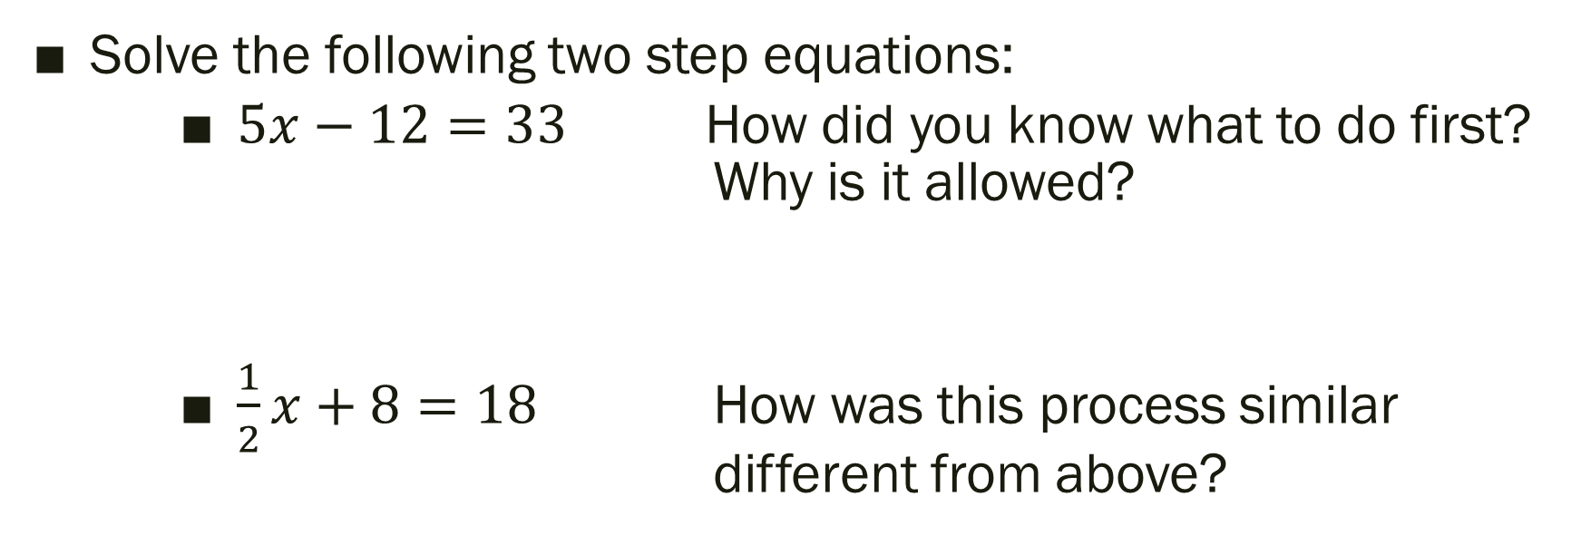
Let’s Get Started…
Solve the following two step equations:
$5x−12=33$ How did you know what to do first? Why is it allowed?
$\frac{1}{2}x+8=18$ How was this process similar different from above?

Slide 4

How about now…
Solve the following.
$2^{x}=16$
What do you notice about this one?
$4^{x}=20$

Slide 5
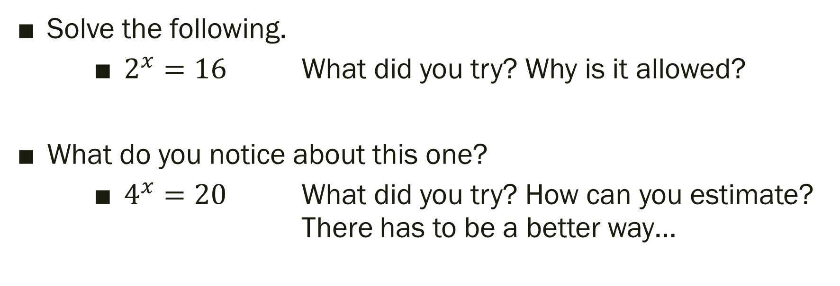
How about now…
Solve the following.
$2^{x}=16$ What did you try? Why is it allowed?
What do you notice about this one?
$4^{x}=20$ What did you try? How can you estimate? There has to be a better way…

Slide 6

$$\log_{b}y=x <=> b^{x}=y$$
Read: “log base b of y equals x”
Read: “b to the x power equals y”

Slide 7

Logarithmic Form
Exponential Form
$$\log_{b}y=x <=> b^{x}=y$$
Logarithms are the Inverse of Exponentials

Slide 8





Logarithmic Form
Exponential Form
$$\log_{b}y=x <=> b^{x}=y$$
Rewrite the following:
$$2^{6}=64$$
$$\log_{3}81=4$$
$$7^{−2}=1/49$$
$$\log_{16}4=1/2$$

Slide 9
Turn and Tell Your Partner…
What is the purpose of a logarithm?

Slide 10

What can we do to solve?
$$4^{x}=20$$

Slide 11
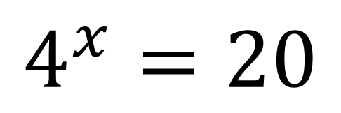
What can we do to solve?
CHOP IT DOWN!
The logs will have the same base!
$$4^{x}=20$$

Slide 12

What can we do to solve?
$$4^{x}=20$$
Rewrite as a logarithm.
What the heck does that even mean?!
Grab your calculator.
How did it compare to our answer from before?

Slide 13
Turn and Tell Your Partner…
Now describe the purpose of a logarithm.
What did you modify, add, keep?

Slide 14
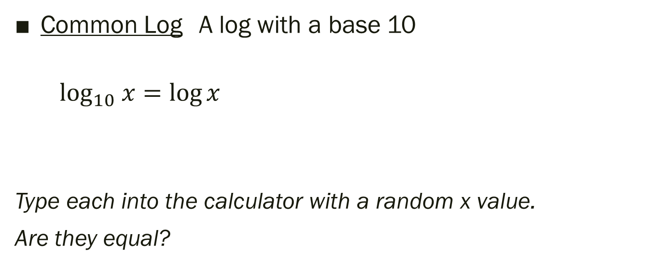
A special case
Common Log A log with a base 10
$\log_{10} x=\log{x}$
Type each into the calculator with a random x value.
Are they equal?

Slide 15
Turn and Tell Your Partner…
Describe the similarities and differences
between rewriting and evaluating a logarithmic function.

Slide 16
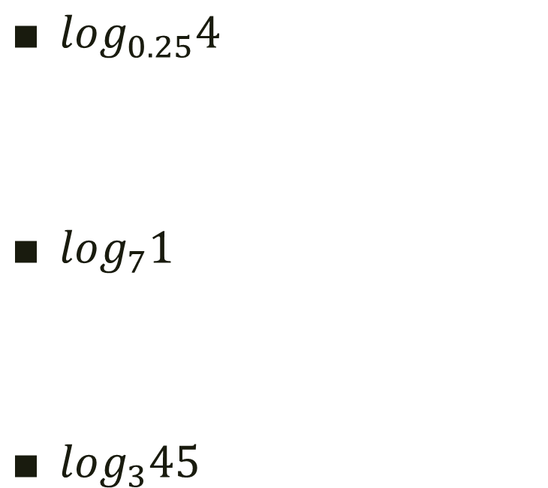
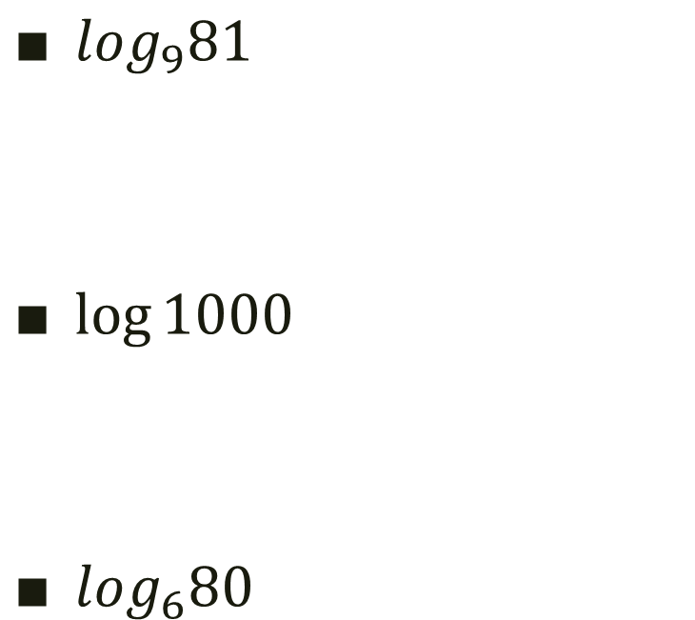
Exit Ticket: Evaluate
$\log_{9}81$
$\log{1000}$
$\log_{6}80$
$\log_{0.25}4$
$\log_{7}1$
$\log_{3}45$

